Slide 1


Data Preprocessing
Gabriel Avelino Sampedro, Ph.D.
Chairman, Korean Institute of Communications and Information Sciences - PH Section
Founder / CEO, Philippine Coding Camp

Slide 2
DATA ANALYSIS

Slide 3
DATA ANALYSIS
Leek, J. and Peng, R. (2015, March 20). What is the Question?
Science Magazine, 347(6228), pp. 1314-1315.

Slide 4



DATA ANALYSIS
Exploratory Data Analysis (EDA) requires you to:
Investigate
Get a first look of the data
Understand
Gain an understanding of the
data and its properties
Hypothesize
Form new hypothesis and ask
more questions for additional
data collection and
experiments

Slide 5



DATA ANALYSIS
Exploratory Data Analysis (EDA) involves:
Summary Statistics
Measure of central tendency,
measure of dispersion, etc.
Data Cleaning
Fixing inconsistencies,
removing invalid records,
handling missing values
Data Visualization
Scatterplot, dot plot,
histogram, box plot

Slide 6
DATA ANALYSIS
Some things to find out in the process of doing EDA:
    Different information that are available in the data
    Range of values of each variable
    Distributions of different variables
    Presence of outliers, if any
    Comparisons between different variables
    Comparisons between groups of observations
    Testing of personal assumption about the data

Slide 7
DATA ANALYSIS
Regarding the format and the metadata
    What does each observation represent?
    What does each variable represent?
    Can I treat each row as individual records? Are there duplicates?
    Are there missing data to consider?
    What is the unit of measure for each variable?

Slide 8
DATA ANALYSIS
Regarding the domain
    What do the terms/jargons in the dataset mean?
    In Financial Trading data – bid volume, bid-ask volume misbalance, signed transaction volume, spread volatility, bid-ask spread
    In Epidemiology data – basic reproduction number, generation time, incidence, serial interval, vaccine efficacy

Slide 9
DATA ANALYSIS
Regarding the domain
    Is the dataset a population or a sample in the context of the research question?
    Are there possible biases in the dataset?
    Is the data collection consistent across all observations?
    Is it grouped?
    Is it simulated?

Slide 10
DATA ANALYSIS
Regarding previous processing involved
    Are there previous processing performed on the data?
    Normalization – numerical values have been normalized to a set range?
    Discretization – numerical data has been grouped together into categories?
    Interpolation – are some values estimated from others?
    Truncation – some observations have been removed?

Slide 11
DATA ANALYSIS
Regarding the data
    Describe each variable in the dataset.
        Summary statistics, frequency tables, histograms, etc.
    Describe the relationship between pairs of variables.
        Scatterplots, correlation tables, etc.

Slide 12
DATA ANALYSIS
Regarding each variable
    What is the measure of central tendency?
        Mean, median, mode, trimmed mean, etc.
    What is the measure of dispersion?
        Range, IQR, standard deviation
    What does the distribution look like?
        Symmetric, positively skewed, negatively skewed, etc.

Slide 13
DATA ANALYSIS
Regarding relationships between variables
    Is there a relationship between two variables?
        Measures of correlation (Pearson, Spearman, etc.)
        Scatterplot, correlation tables, etc.
    Use the corr() function in pandas for this.

Slide 14
DATA ANALYSIS
Regarding outliers and anomalies
    Are there outliers? Errors in encoding?
    Are there needed preprocessing steps to visualize and process the data properly?

Slide 15
DATA ANALYSIS
Regarding outliers and anomalies
Rape data in Boulder, CO (1960-2004)
Maltz, M. D. (2010). Look before you analyze: Visualizing data in criminal justice. In Piquero, A. . and Weisburd, D., editors, Handbook of Quantitative Criminology, chapter 3, pages 25-52. Springer New York, New York, NY.

Slide 16
DATA ANALYSIS
Regarding outliers and anomalies
Murder Data in Oklahoma City (1960-2004)
Maltz, M. D. (2010). Look before you analyze: Visualizing data in criminal justice. In Piquero, A. . and Weisburd, D., editors, Handbook of Quantitative Criminology, chapter 3, pages 25-52. Springer New York, New York, NY.

Slide 17
DATA ANALYSIS
Regarding additional columns
    Are there additional columns to add to the dataset?
Computed index
Poverty index
H-index
BMI
Feature pairs
Male + old
Cough + fever
Generated features
Nearest grocery
Time duration
Date difference

Slide 18
SUMMARY STATISTICS

Slide 19
SUMMARY STATISTICS
Measure of Central Tendency
54, 54, 54, 55, 56, 57, 57, 58, 58, 60, 60
Mean = 56.6
Median = 57
Mode = 54

Slide 20
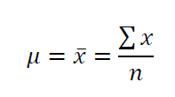
SUMMARY STATISTICS
Mean
Advantages
Used for both continuous and discrete numeric data.
Disadvantages
This cannot be calculated for categorical data. This is easily influenced by outliers.

Slide 21
SUMMARY STATISTICS
Trimmed Mean
Same as mean, but removing 𝑛% of the highest and lowest values in the dataset
Advantages
Used for both continuous and discrete numeric data.
Disadvantages
This cannot be calculated for categorical data.

Slide 22
SUMMARY STATISTICS
Median
The value separating the upper half and the lower half of the sample/population.
Advantages
  This is less affected by outliers and skewed data than the mean. Preferred when the distribution is not symmetrical.
Disadvantages
This cannot be calculated for categorical data.

Slide 23
SUMMARY STATISTICS
Mode
Most frequent occurring value in the sample/population
Advantages
This can be calculated for numerical and categorical data.
Disadvantages
  This may not reflect the center of the distribution very well. When the data are continuous, it may have no mode at all.

Slide 24
SUMMARY STATISTICS
Measure of Dispersion
Range
Interquartile Range
Variance
Standard Deviation

Slide 25
SUMMARY STATISTICS
Range
Difference of the maximum and the minimum values of the dataset
Advantages
Easy to calculate
Disadvantages
  This is very sensitive to outliers and does not use all the observations in a data set.

Slide 26
SUMMARY STATISTICS
Interquartile Range
Difference of the median of the upper half and the median of
the lower half (𝑄3 − 𝑄1)
Advantages
This can be used as a measure of dispersion if the extreme values are not being recorded exactly.
Disadvantages
  Issues with sampling stability

Slide 27
SUMMARY STATISTICS
Standard deviation
Square root of the variance
Advantages
This is based on every item of the distribution
Disadvantages
  This can be impacted by outliers and extreme values

Slide 28
SUMMARY STATISTICS
Correlation
Pearson Correlation
Spearman Correlation

Slide 29
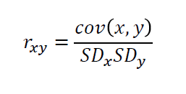
SUMMARY STATISTICS
Pearson Correlation
Assesses the linear relationship between two variables.

Slide 30
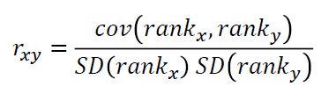
SUMMARY STATISTICS
Spearman Correlation
Assesses the monotonic relationship between two variables
(whether linear or not).

Slide 31
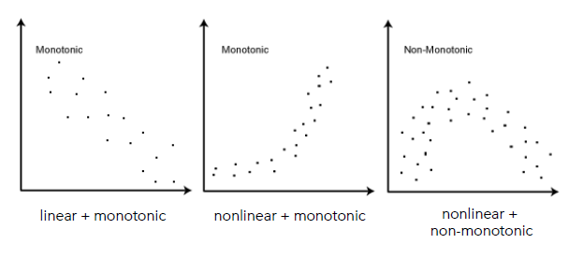
SUMMARY STATISTICS

Slide 32
DATA VISUALIZATION

Slide 33
DATA VISUALIZATION
matplotlib is a package for data visualization in Python that works well with pandas.
Use it to visualize data, which is an important step in exploratory data analysis.

Slide 34
DATA VISUALIZATION
In exploratory data analysis, it is often useful
to visualize the distribution of a dataset.

Slide 35
DATA VISUALIZATION

Slide 36

SUMMARY STATISTICS
Types of plot

Slide 37
DATA VISUALIZATION
Use scatterplot when dealing with paired variables.
This identifies the relation between two variables.

Slide 38
SUMMARY STATISTICS
Correlation Plot

Slide 39
SUMMARY STATISTICS
Histogram
If the data contains numerous observations, it is better to group them into bins and display it in a histogram.

Slide 40
SUMMARY STATISTICS
Histogram
Histograms provide a view of the data density
and can be used to identify modes.

Slide 41
DATA VISUALIZATION
Bar Plot
This displays the data distribution
based on five-number summary:
  Upper Whisker (𝑄3 + 1.5 × 𝐼𝑄𝑅)
  Third Quartile (𝑄3)
  Median
  First Quartile (𝑄1)
  Lower whisker (𝑄1 + 1.5 × 𝐼𝑄𝑅)

Slide 42
Thank you for listening!
Let’s Connect:
Gabriel Avelino Sampedro, Ph.D.
garsampedro@ieee.org
WhatsApp: +63 999 992 9515

